Slide 1
UML

Slide 2
UML
UML stands for Unified Modeling Language.
UML is a language to provide notations for system design and description; it is not a method, because it has no notion of process.
UML is not a formal model that ‘must’ be followed for system development, but a communication tool that helps people understand the features/properties of the system.

Slide 3
People
Three amigos: Grady Booch, James Rumbaugh, and Ivar Jacobson.
In 1994, Rumbaugh left General Electric to join Booch at Rational Software.
In 1995, they introduced Unified Method. Meanwhile, Jacobson jointed them at Rational Software.
In 1996, they proposed UML.

Slide 4
9 Major Modeling Diagrams
Use case diagrams
Class diagrams
Object diagrams
Sequence diagrams
Collaboration diagrams
State diagrams
Activity diagrams
Component diagrams
Deployment diagrams

Slide 5
Use Case Diagrams
Use case diagrams describe what a system does from the standpoint of an external observer. The emphasis is on what a system does rather than how.
Use case diagrams are closely connected to scenarios. A scenario is an example of what happens when someone interacts with the system. Here is a scenario for a medical clinic.
A use case is a summary of scenarios for a single task or goal
An actor is who or what initiates the events involved in that task. Actors are simply roles that people or objects play.
The connection between actor and use case is a communication association (or communication for short).

Slide 6
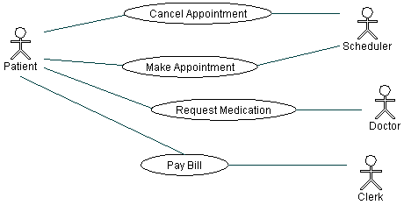
Use Case Diagrams

Slide 7
The Uses of Use Case Diagrams
Determine features (requirements).
New use cases often generate new requirements as the system is analyzed and the design takes shape.
Communicate with clients.
Their notational simplicity makes use case diagrams a good way for developers to communicate with clients.
generating test cases.
The collection of scenarios for a use case may suggest a suite of test cases for those scenarios.

Slide 8
Class Diagrams
A Class diagram gives an overview of a system by showing its classes and the relationships among them. Class diagrams are static -- they display what interacts but not what happens when they do interact.
A Domain Diagram is a Class Diagram without operations. Domain diagrams help to specify the domains of the application in early system analysis/design phase.

Slide 9
Class Diagrams
There are three kinds of relationships between classes in the diagrams:
association -- a relationship between instances of the two classes. There is an association between two classes if an instance of one class must know about the other in order to perform its work. In a diagram, an association is a link connecting two classes.
aggregation -- an association in which one class belongs to a collection. An aggregation has a diamond end pointing to the part containing the whole. In our diagram.
generalization -- an inheritance link indicating one class is a superclass of the other. A generalization has a triangle pointing to the superclass.

Slide 10
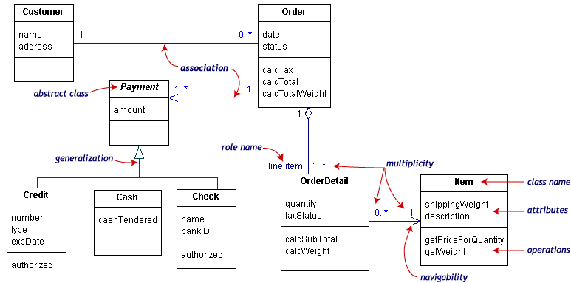
Class Diagrams

Slide 11
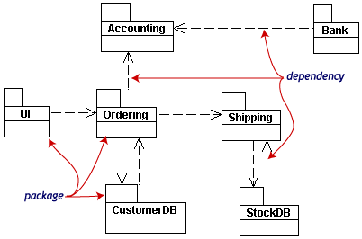
Packages
To simplify complex class diagrams, you can group classes into packages. A package is a collection of logically related UML elements.

Slide 12
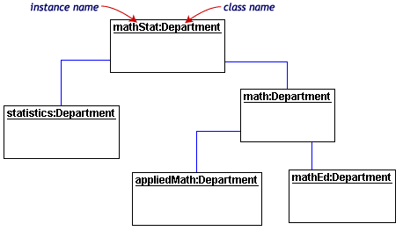
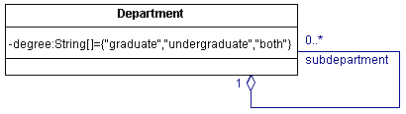
Object Diagrams
Object diagrams show instances instead of classes. They are useful for explaining small pieces with complicated relationships, especially recursive relationships.

Slide 13
Sequence Diagrams
Class and object diagrams are static model views. Interaction diagrams are dynamic. They describe how objects collaborate. Interaction diagrams include sequence diagrams and collaboration diagrams.
A sequence diagram is an interaction diagram that details how operations are carried out -- what messages are sent and when. Sequence diagrams are organized according to time. The time progresses as you go down the page. The objects involved in the operation are listed from left to right according to when they take part in the message sequence.

Slide 14
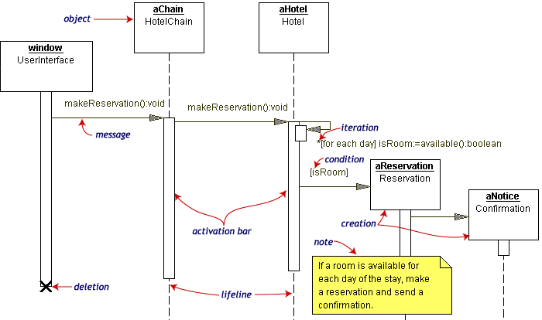
Sequence Diagrams

Slide 15
Sequence Diagrams
A sequence diagram usually specifies a use case in the use case diagram.
When considering “error handling” in a use case, each error handling should be specified in a different sequence diagram.

Slide 16
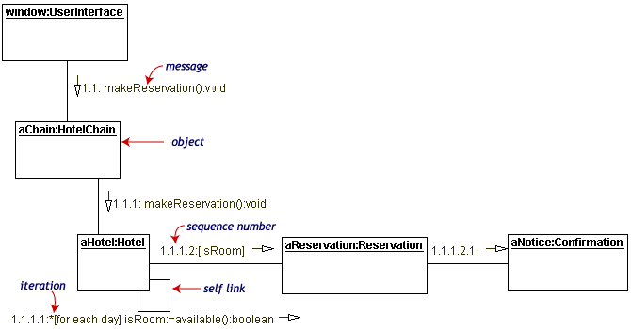
Collaboration Diagrams
Collaboration diagrams are also interaction diagrams. They convey the same information as sequence diagrams, but they focus on object roles instead of the times that messages are sent.

Slide 17
State Diagrams
Objects have behaviors and state. The state of an object depends on its current activity or condition. A state diagram shows the possible states of the object and the transitions that cause a change in state.
Elements
Event[Guard Condition]/Action
Initial and ending (final) states
States and transitions
Activities inside states
Actions are associated with transitions and are considered to be processes that occur quickly and are not interruptible. Activities are associated with states and can take longer. An activity may be interrupted by some event.
State diagrams can be nested.

Slide 18
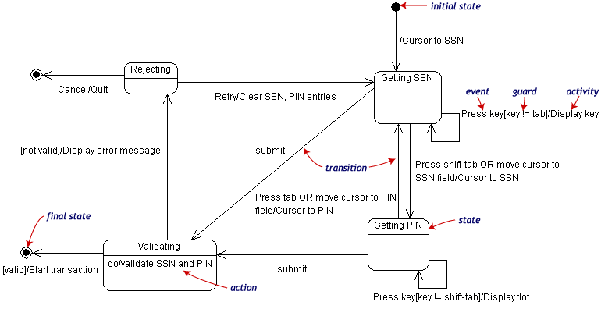
State Diagrams

Slide 19
Activity Diagrams
An activity diagram is essentially a fancy flowchart.
Elements
Activity diagrams can be divided into object swimlanes that determine which object is responsible for which activity
A transition may branch into two or more mutually exclusive transitions. Guard expressions (inside [ ]) label the transitions coming out of a branch.
A branch and its subsequent merge marking the end of the branch appear in the diagram as hollow diamonds
A transition may fork into two or more parallel activities.
The fork and the subsequent join of the threads coming out of the fork appear in the diagram as solid bars.

Slide 20
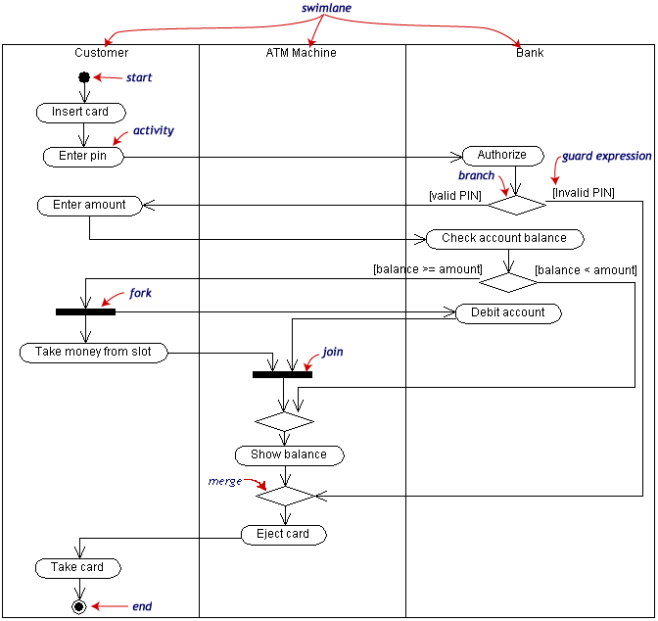
Activity Diagrams

Slide 21
Physical Diagrams
Physical diagrams include Component Diagrams and Deployment Diagrams.
A component is a code module. Component diagrams are physical analogs of class diagram
Deployment diagrams show the physical configurations of software and hardware.

Slide 22
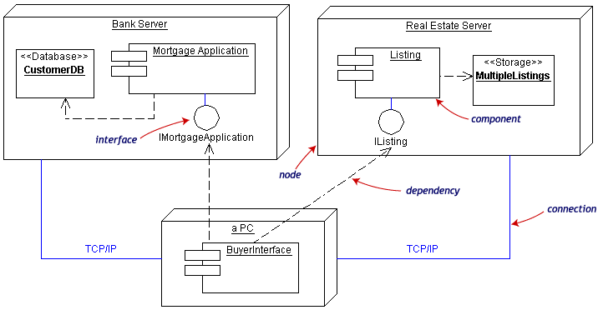
Physical Diagrams

Slide 23
The Use of UML
Evaluate problems, determine these significant terms that are going to be in the system (objects, attributes, operations…).
Requirement analysis-use Use Case Diagrams, Domain Diagrams, and State Diagrams to analyze system requirements and communicate with customers.
System design-use Sequence Diagram a,d Collaboration Diagrams to understand system behaviors. Use the other diagrams to help understand the details of these behaviors and relationships.
Detailed design-detail Domain/Class Diagrams, including the functions and processes of operations in each object (Pseudo code)
You are ready for coding.

